Slide 1
Malaria Cell Image Classification
Prepared by: Syeda Saiara Lubaba
ID: 1510876042

Slide 2
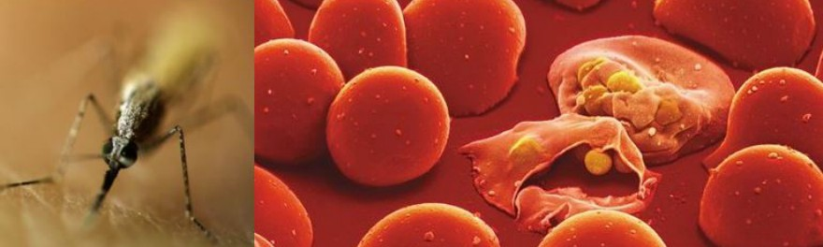
Overview
This project will detect whether an image of a human cell is malaria infected or not.

Slide 3
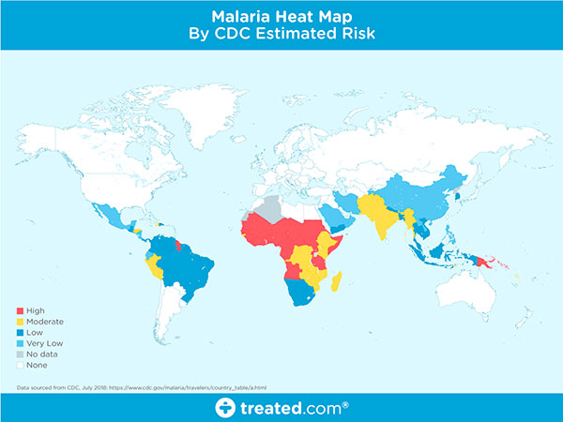
Motivation
Malaria still is a global health problem
The current standard method for manual diagnostic system is time consuming

Slide 4
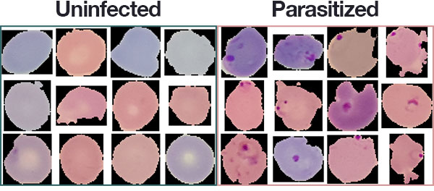
Dataset
The dataset of this project is collected from National Institute of Health (NIH) of USA.
Link: https://lhncbc.nlm.nih.gov/publication/pub9932
This dataset contains 27,558 cell images with an equal number of parasitized and uninfected cells.

Slide 5
Tools
Keras with a Tensorflow backend
Numpy
Scikit-learn
Matplotlib
Imutils

Slide 6
Work Update
Dataset Preparing
Image Processing
Data Splitting

Slide 7
Future Work Plan
Will train the model with Convolutional Neural Network (CNN)
Will try to maximize the accuracy

